Slide 1
Internet & Mobile Marketing:
Stories from an Entrepreneur
Adam Cheyer
April 2010

Slide 2
Entrepreneurship: How I got here
Verbally stated goal:
  “5 Projects that can Impact Many Users in 2007”
5 projects developed
  CALO Express (with Steve Hardt, Leslie Pound)
  WubHub/SourceMix (with Josh Levy)
  Change.org (with Ben Rattray, Mark Dimas)
  Siri (with Didier Guzzoni, Norman Winarsky)
  Genetic Finance (with Antoine Blondeau, Babak Hodjat)
Prototypes and business picture
  STP: Segmentation/Targeting/Positioning
  NABC: Need/Approach/Benefits/Competition

Slide 3
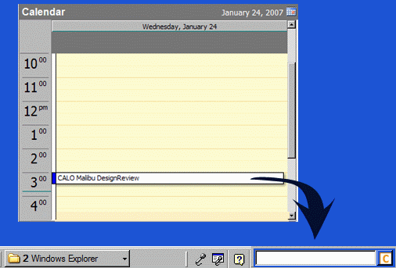
CALO Express
Audience: Office workers (Windows)
Need: Information Management (email, ppt, mtgs)
Approach: “Invisible” integration into MS tools
learning based algorithms
Benefits: More organized & prepared, less time
Competition: Google Desktop, MS Search
Learning-based functions
CALO SEARCH ASSISTANT
  Quickly finds content and answers questions
CALO NEWS ASSISTANT
  Discovers, organizes and prioritizes your news articles and sources
CALO PREP PAK
  Locates the information you need to prepare for a meeting
CALO POWERPOINT ASSISTANT
  Helps you create and edit presentations
CALO TASK ASSISTANT
  Learns and automates repetitive tasks
CALO MEETING ASSISTANT
  Captures and extracts important information from meetings

Slide 4
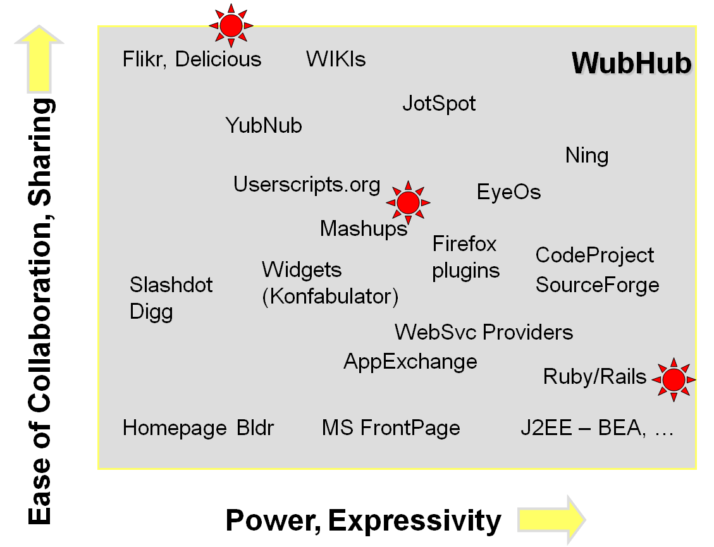
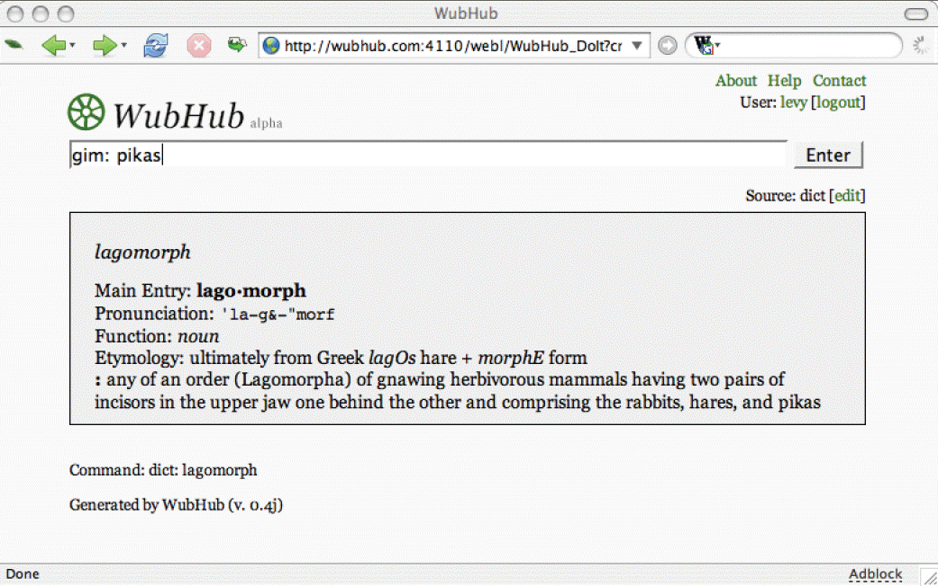
WubHub/SourceMix
Audience: Software developers
Need: Software development too isolated
Approach: Social Wiki for code, data, UI, services
Benefits: Enormous code reuse
Competition: SourceForge, Yahoo Pipes, Ning

Slide 5

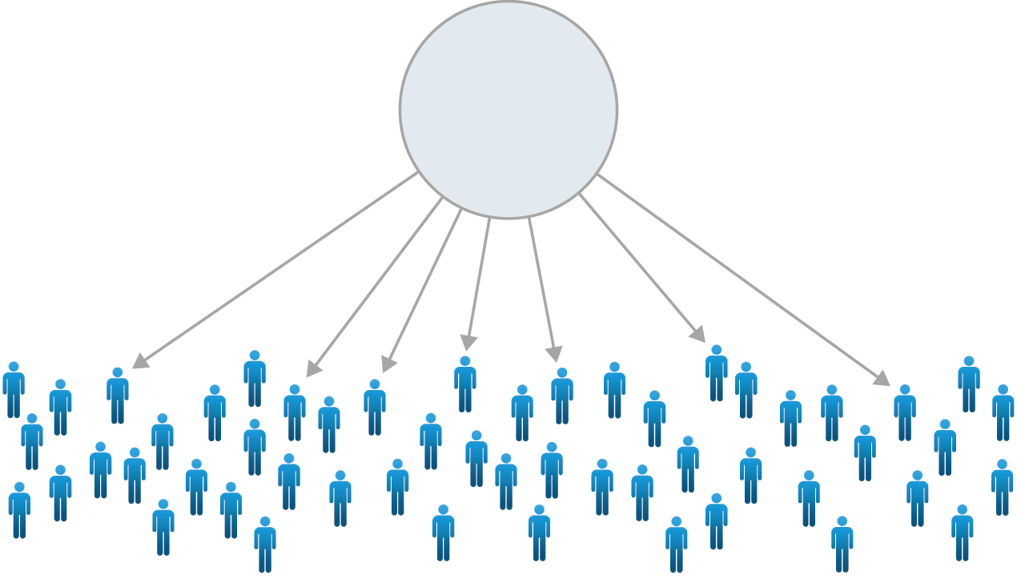
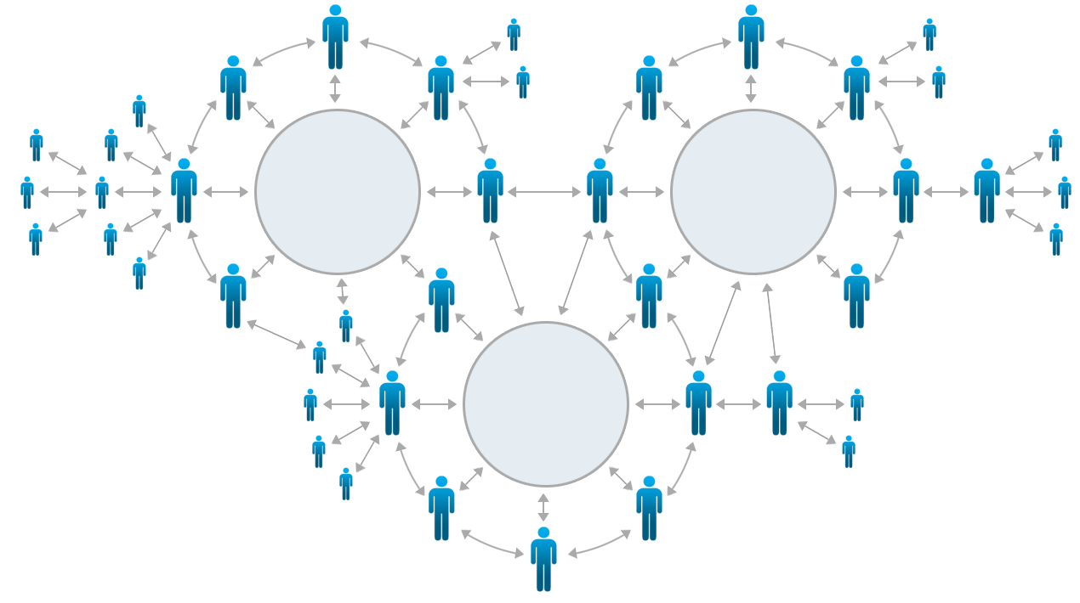
Change.org
Present
Change.org’s Marketplace
Audience: Non-profits, people who want to do good in the world
Need: Donations/giving is broken
Approach: Social network for social activism
Benefits: Sense of community, viral growth
Competition: Blackbaud, Care2, Causes

Slide 6

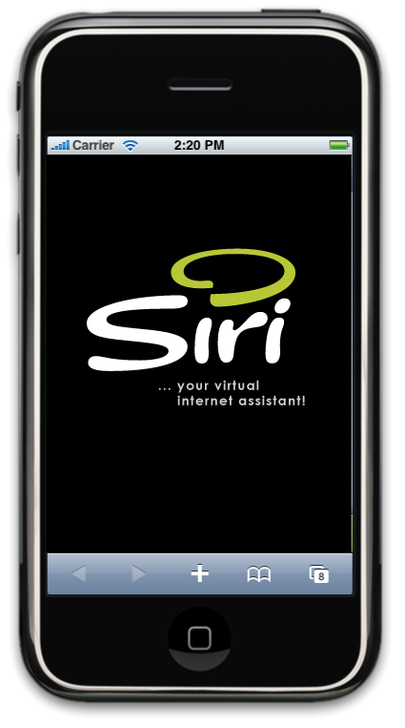
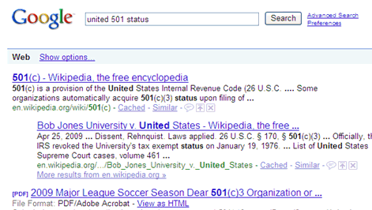
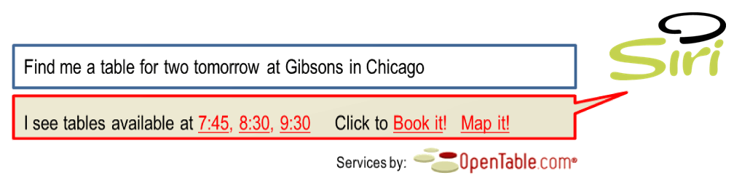
Siri
Search: links to webpages
Virtual Personal Assistant: get it done
Audience: Mobile, web consumers
Need: Too many clicks, too many non-integrated forms/sites
Approach: Virtual Personal Assistant orchestrates web service ecology
Benefits: Time-to-task, frictionless commerce
Competition: Mobile Search (Google, Yahoo, MS), portals (e.g. Expedia, Kayak, Rearden)

Slide 7
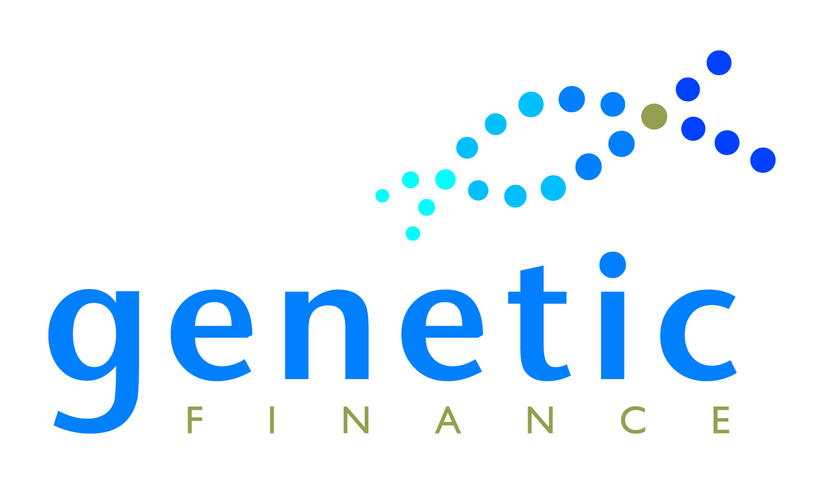
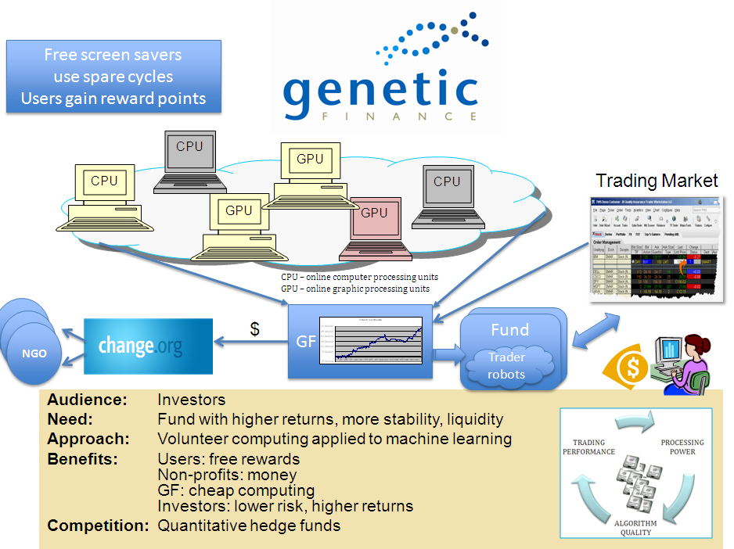
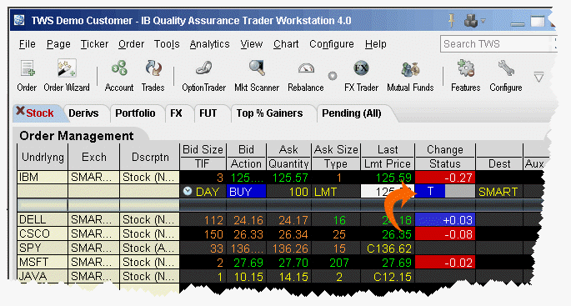

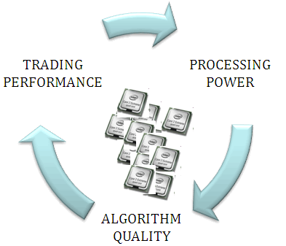
GF
Free screen savers
use spare cycles
Users gain reward points
CPU
GPU
CPU
CPU
Trading Market
GPU
GPU
CPU – online computer processing units
GPU – online graphic processing units
NGO
GF
Fund
NGO
$
Fund
NGO
Trader
robots
Audience: Investors
Need: Fund with higher returns, more stability, liquidity
Approach: Volunteer computing applied to machine learning
Benefits: Users: free rewards
Non-profits: money
GF: cheap computing
Investors: lower risk, higher returns
Competition: Quantitative hedge funds

Slide 8
“One Major, One Minor”
Make it real – raise money, team, take it to market
Which ones did I pick? Why?
  CALO Express… No (bus model, hard to change habits)
  WubHub/SourceMix … No (bus model, changing habits)
  Change.org – Ben and Mark taking it forward, remain advisor
  Siri – Defensible, great business model, consumers want it, timing right
  Genetic Finance – Good IP, lucrative business model, expandable
Observation: Both “winners” had a platform + an app + a business model
Synergies across projects
  GF → Change.org
  Siri → CALO Express, SourceMix

Slide 9
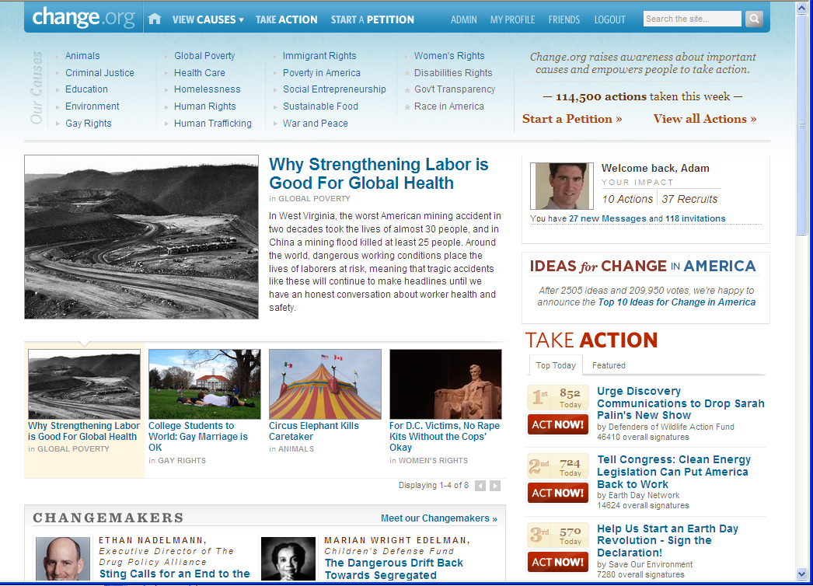
Lessons from Change
Today: top 3000 site in US, ~10000 in world

Slide 10
Mission
Change.org aims to transform the $220 billion market for philanthropy and political activism by creating an online network that:
Connects people and nonprofits worldwide, and
Empowers them to magnify their social impact

Slide 11
Problem
Traditional means of fundraising & engagement are broken
  Difficulty Attracting Donors: 0.25% - 2% response rates to solicitations
  Difficulty Retaining Donors: 20% of new donors remain supporters after 2 years
Donors complain about bad giving experience
  Impersonal
  Aggressive solicitations
  No sense of real impact
  Treated as a cash machine instead of a valued member of a community
The consequence: fundraising expenses rose to $50 billion in ’06 while millions remained inactive

Slide 12
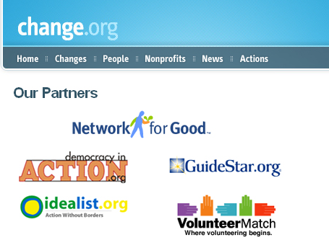
Marketing & Distribution (to nonprofits)
Partner Channels
  Nonprofit Software Vendors
    Network for Good (10,000 clients)
    Democracy in Action (500 clients)
    Others: Convio, Kintera, Capitol Advantage, Salesforce Foundation, Blackbaud
  Other Nonprofit Service Providers
    GuideStar (150,000 nonprofits)
    Idealist.org (60,000 nonprofits)
    VolunteerMatch (40,000 nonprofits)
    Others: Craigslist Foundation, Nonprofit Congress

Slide 13

Marketing & Distribution (to donors)
Via Nonprofit Users
  Many nonprofits: tens-hundreds of thousands of emails
  DIA clients alone: 20,000,000 unique email addresses
Viral (peer-to-peer)
  Users compete to raise the money and recruit friends
  Mimic strategy of successful nonprofits: petitions
Leveraging Existing Social Networks
  Users can distribute their profile across the web

Slide 14
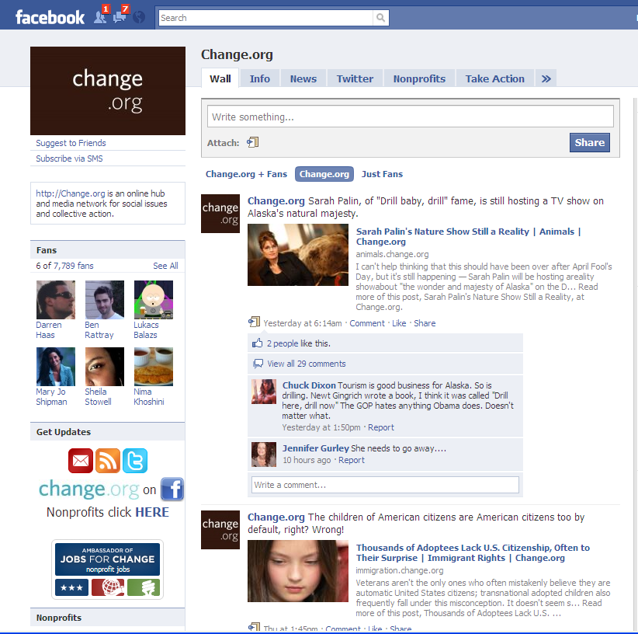
Lessons Learned
Lesson: Jump early on viral tech
  One of first Facebook Apps (but not early enough)
  Integrations with facebook, myspace, badges

Slide 15
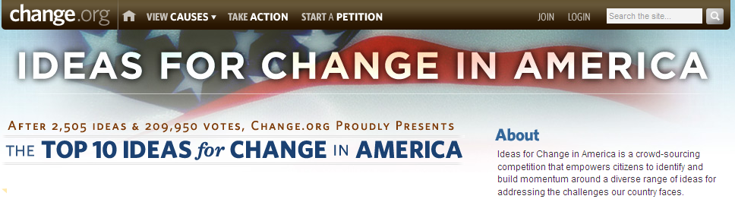
Lesson: Viral Games
“Ideas for America Competition”
Political Quiz
  Leads people through funny questions/animations (fun experience), then invites them to sign up, and to share with friends

Slide 16
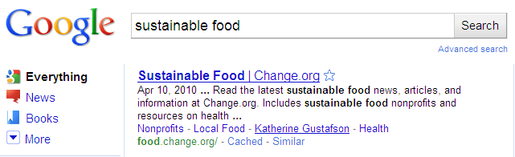

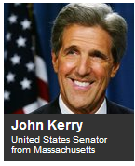
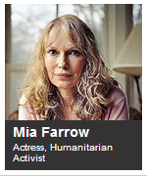
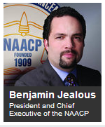
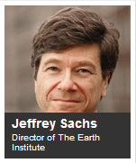
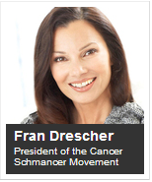
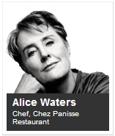
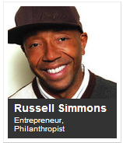
Lesson: SEO
Focus 10,000+ “Changes” → ~15 causes
Goal: be top search result in each area
Blogging key
  Hired blogger/editor per cause
  Ran
  “Changemakers”

Slide 17

Lesson: Weekly Emails

Slide 18
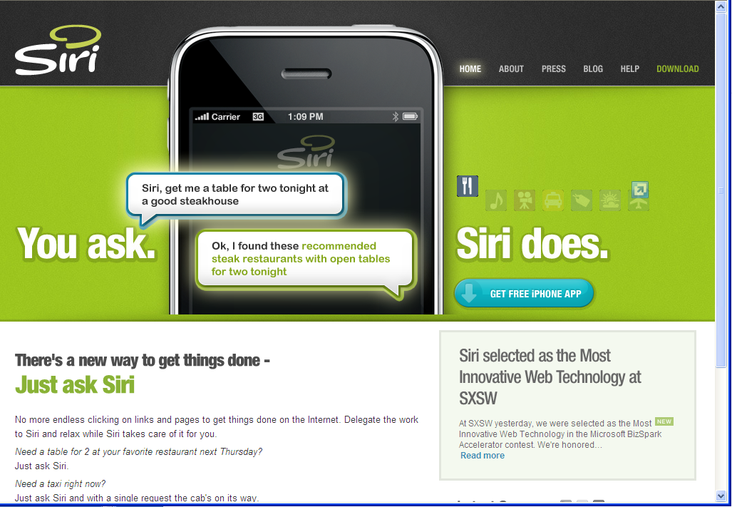
Lessons from Siri

Slide 19
Converging Trends
Web Services Explosion (10,000’s)
  Yet, no “Google of Web Services”
Maturation of key AI technologies
  Speech, natural language, machine learning
    CALO Project: $200M in DARPA funding
Mobile is finally here
  Thank you iPhone… (34M phones sold by 2009)
  Competitive response (Android, Palm Pre)
  Smartphones will make up more than 50% of new phones sold by Verizon (90M subscribers) in 2010

Slide 20
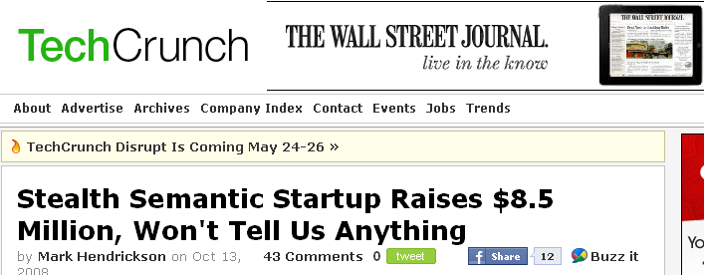
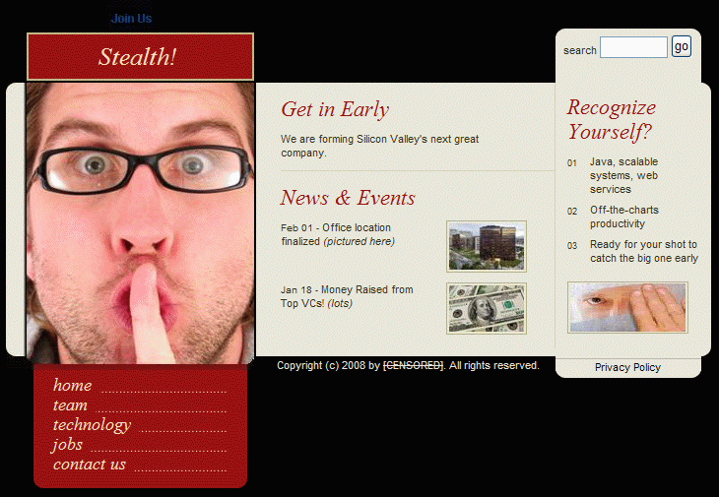
Lesson: less can be more…
Stealth-Company.com

Slide 21














Good PR Company worth it
Launch!

Slide 22
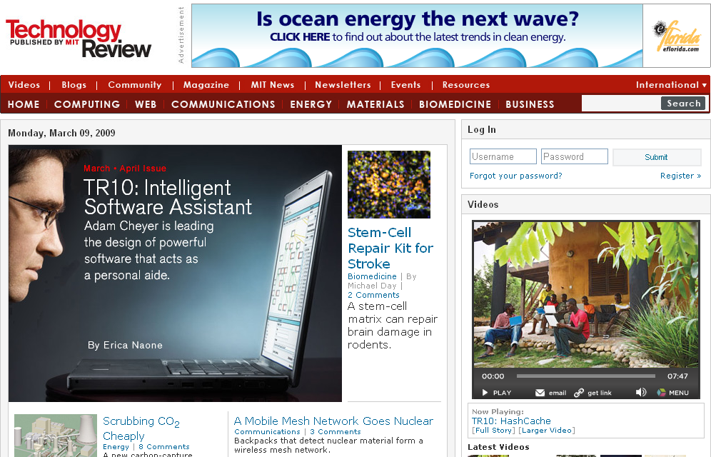
Good PR Company worth it

Slide 23
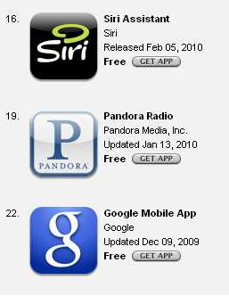
iTunes App Store Strategies
App Store positioning helps – for a while
  Top 100 overall and Top 10 in category leads to increased downloads
    Top 15 yields about +40K daily
    Top category about +10K daily
  Velocity based: rate of change big factor, so effect only lasts short time
Top Free Apps

Slide 24

















Fame can be fleeting as apps gun for pole position on weekends
8 apps in top lifestyle spot in past 3 wks.; no one in top spot > than 5 days
> 15 in top 5 lifestyle spots in past 3 weeks
Admob: Burst campaigns popular
Admob network traffic increases 30% on weekends.
Companies target spend for Thurs./Friday to get in position for the weekend.

Slide 25
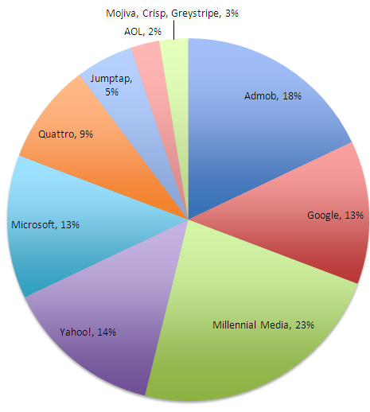



Advertising?
Tried burst campaigns with a few mobile advertisers
  Saw some benefit but not enough to continue

Slide 26
Distribution and Expansion
Working with major distribution partner
2010 is about expansion
  More phones
  More domains/services
  More countries
  More languages
  More modalities (web, car, home)

Slide 27
Thank You
Adam Cheyer
VP Engineering
Siri, Inc
acheyer@siri.com

