Slide 1
The Future Of AI What’s Possible, What’s Not, How Do We Get There?
Adam Cheyer Co-Founder, VP Engineering
Siri Inc

Slide 2
The Future of AI
Who is this person? What does he know and not know?
AI: What are we trying to achieve?
What does it require?
Why is it hard?
What approaches are there?
What works well?
What doesn’t?
We need a breakthrough! How do we get one?
Where is the state of the art today?
Research labs
Commercial world
What are our best hopes of success?
What holds us back?
What does the future look like?
In 5 years.... In 15… In 25…

Slide 3
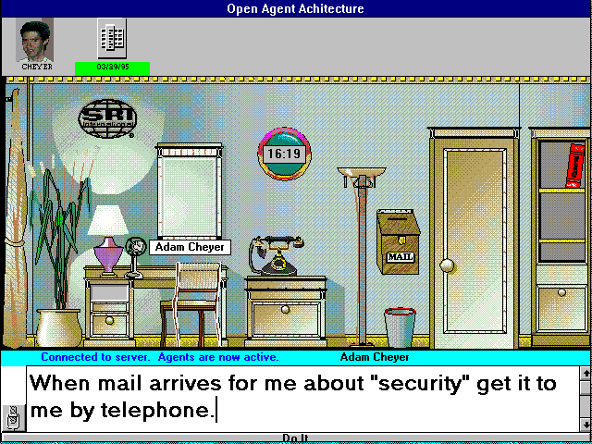
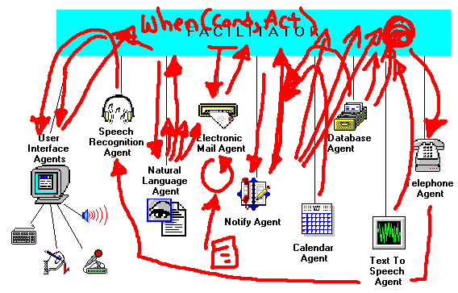
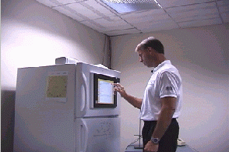
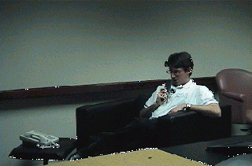
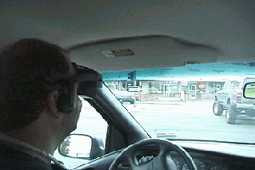
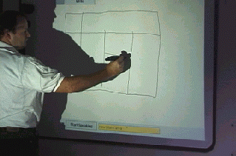
Who is this person?
1993-1999: SRI researcher in the AI Center
Open Agent Architecture (OAA)
Computer Human Interaction Center (CHIC)
Connecting distributed people, AI, Web Services, Data, mix real/virtual world

Slide 4
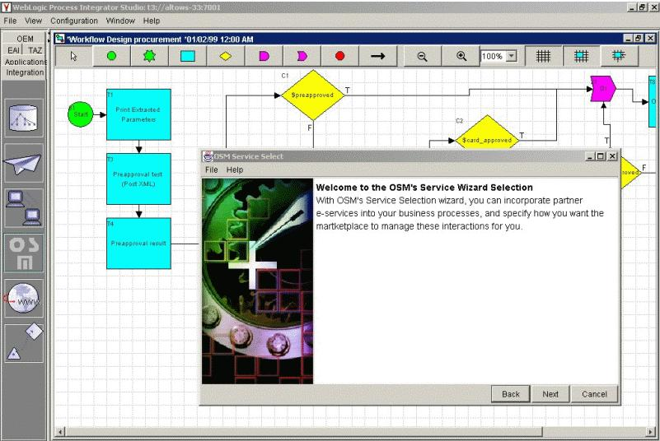
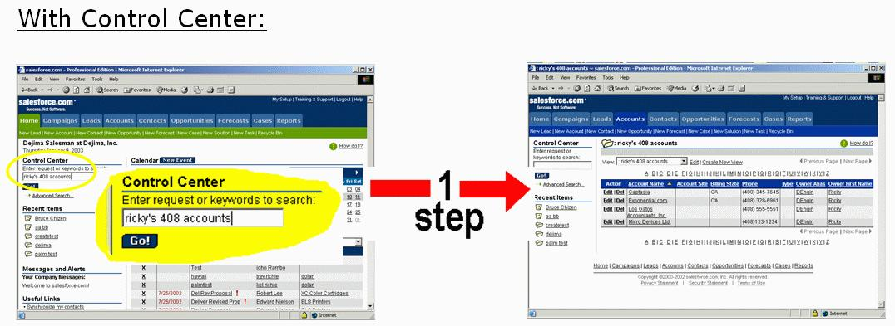
Who is this person?
1993-1999: SRI researcher in the AI Center
1999-2003: VP Engineering
Public company
Startup

Slide 5
Who is this person?
1993-1999: SRI researcher in the AI Center
1999-2003: VP Engineering
2003-2008: Chief Architect, CALO. Developed several collab. projects
Collaborative Systems Read: writings by Doug Engelbart
CALO: “Big AI”
Tension

Slide 6
Who is this person?
1993-1999: SRI researcher in the AI Center
1999-2003: VP Engineering
2003-2008: Chief Architect, CALO. Developed several other projects.
2008-present: Co-founder
Your Virtual Personal Assistant
Massive-scale machine learning for financial prediction
Knowledge
Statistical

Slide 7
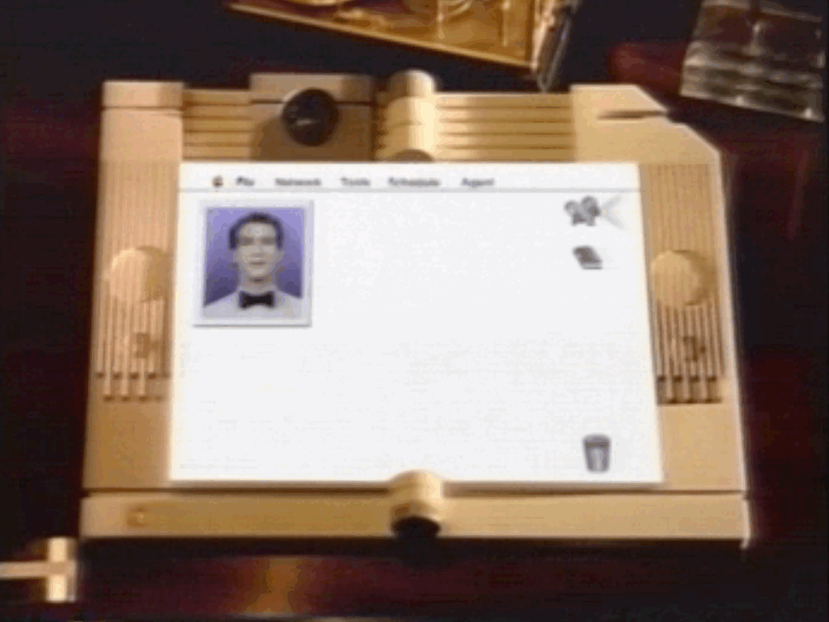
AI: What are we trying to achieve?
Apple’s Knowledge Navigator (1987)

Slide 8
Interaction with the Assistant
Touch screens and cinematic animation
Global network for info and collaboration
Awareness of temporal and social context
Continuous Speech in and out
Conversational Interface - assistant talks back
Delegation of tasks to the assistant
Assistant use of personal data

Slide 9
Is the Knowledge Navigator vision possible today?

Slide 10
Is the Knowledge Navigator vision possible today?
No.
But we're getting there.

Slide 11
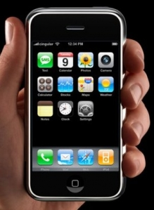
How Close are we Today?
Touch screens
Cinematic effects
Global network
Location and time awareness
Speech out, on demand
Continuous speech to text
But where is the interface for assistance?

Slide 12
You just can't talk to a search engine this way.
"The future of search is a conversation with someone you trust."
-- John Battelle, The Search

Slide 13
What does it require?
Conversational Interface
Location Awareness
Speech to Text
Semantic Data
Time Awareness
Text to Intent
Services APIs
Task Awareness
Dialog flow
Task & Domain
Models
Access to Personal Information
Preferences
Reasoning
Planning
Scheduling
Learning
And it all needs to work together…

Slide 14
Why is it hard?
Each component technology is complex
Informal, incomplete grammar of English is larger than 1,700 pages R. Quirk et al., A Comprehensive Grammar of the English Language, Longman, 1985.
book 4 star restaurant in Boston
city
+ 43 other fragment interpretations…
Restaurant name
8 Boston’s in US…
These combine into many valid interpretations

Slide 15
Why is it hard?
“Common sense” knowledge is fundamental to all components
Don’t yet have sufficient representations for logical reasoning
*Huge* amounts of knowledge required, where does it come from?
How to manage the scale of the two?
Each component area uses different technologies, languages, methods yet deep integration is fundamentally required

Slide 16
What approaches are there?
Simple heuristic rules plus enormous computation (search)
“Deep” knowledge approach
Typically relies on hand-coded grammars, ontologies, and rules
Statistical approach relying on learning probabilities from large corpora

Slide 17
What works well?
All the approaches work well – for some problems
Massive search with simple heuristics
Deep Blue beats world chess champion
Genetic Finance beats benchmarks on stock prediction
Statistical training based on massive data
Speech recognition
Machine translation
Web search
Read: “The Unreasonable Effectiveness of Data”
“Deep” knowledge approach
Urban Challenge/Robotics
Multiplayer Virtual Games

Slide 18
What doesn’t?
But they have their limitations
Massive search with simple heuristics
Only certain problems fit into this category
Statistical training based on massive data
Again, works only for certain problems due to availability of data and shallowness of scope
“Deep” knowledge approach
Too brittle
How to get the data?

Slide 19
We need a breakthrough! How do we get one?
A “Manhattan Project” for AI?
CALO: 5 years, $200M+, 400 of top AI researchers working together on a single system
An ambitious startup learning lessons from real data, real users
Siri: 20 people, $8M, 2 years, commercialization requirements
Both?

Slide 20
State of the Art: CALO

Slide 21
CALO Research Leaders

Slide 22
Two CALO Highlights
Probabilistic Consistency Engine
Task Learning

Slide 23
State of the Art: Commercial
True Knowledge
MetaWeb
Wolfram Alpha
Radar Networks
Siri: Virtual Personal Assistant

Slide 24
the Virtual Personal Assistant
A new paradigm of consumer interaction with devices & services
Like a human assistant,
You tell it what you want to do.
It will help you get things done.
It gets better over time

Slide 25
The Evolution of Interactions
Find
Find me a table for two tomorrow at Gibsons in Chicago
I see tables available at 7:45, 8:30, 9:30 Click to Book it! Map it!
Services by:
Desktop
Browse
Search
Solve
Windows, Files
Directories, bookmarks
Keywords, links
Tasks, context

Slide 26
The Evolution of Interactions
Find
Send me the book Shibumi by Trevanian
Found it. Will send Shibumi to your home address. $14.95 Confirm
Services by:
Desktop
Browse
Search
Solve
Windows, Files
Directories, bookmarks
Keywords, links
Tasks, context

Slide 27
The Evolution of Interactions
Find
Send my wife some flowers
Desktop
Browse
Search
Solve
Windows, Files
Directories, bookmarks
Keywords, links
Tasks, context

Slide 28
DEMO

Slide 29
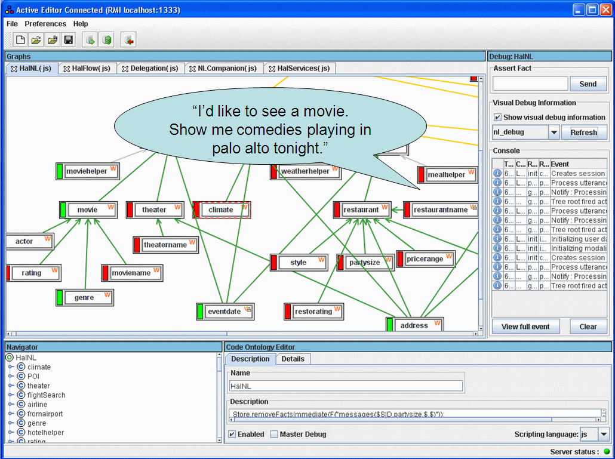
Siri’s Cortex^{tm} Platform
Unified Platform Integrating AI Technologies
Knowledge
Data
Language
Dialog
Personalization
Learning
Knowledge
Data
Language
Context
Dialog
Learning
Task Models
Service Coordination
Transactions

Slide 30
What are our best hopes of success?
Integrating many AI components into single system
Learning from Massive Data
Web, but soon all books, music, tv/video, …
Learning from Massive Usage
The internet population is growing at enormous rate
Learning from Active Teaching & Collaborative Intelligence
Hybrid probabilistic/logical approaches
Or… something completely different
Allen institute for brain science?

Slide 31
What holds us back?
Software
Brittle/fragile
“Anti-Moore’s Law” – gets slower
Ex: boot → MS Word
Human understanding moves slowly
Engelbart: co-evolution of technology and human understanding/adoption
Ex: collective intelligence progress…

Slide 32
AI in the future: 5 Years…
Everyone will have a Siri-like assistant and will rely on it increasingly for
mobile tasks
internet tasks (e.g. travel, e-commerce)
communication tasks
entertainment/attention

Slide 33
AI in the future: 15 Years…
Common sense knowledge models and reasoning components begin to be more feasible – systems seem “smarter”, are less brittle, make less stupid mistakes
Contributions from the masses
Scale issues in probabilistic/logic start to resolve

Slide 34
AI in the future: 25 Years…
Who Knows?

Slide 35
Adam Cheyer
adam@siri.com
Coming later this year Sign up now at Siri.com

